Slide 1
an HST 2008 wg presentation
HST 2008
Long Term Impact of HSTP/NTP
co-ordinated by
Snejana & Rajesh

Slide 2
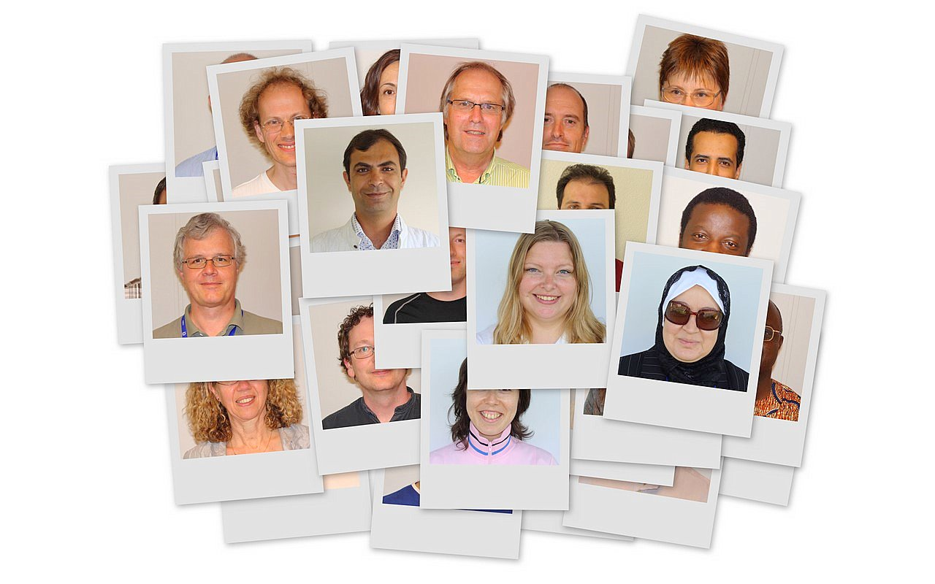
38 teachers
HST 2008
from 30 countries
with different cultures
have come to CERN
for common objectives….

Slide 3
and one of the objective is
HST 2008
To evaluate the
“impact of the program”
on ‘us’
and on ‘our students’

Slide 4
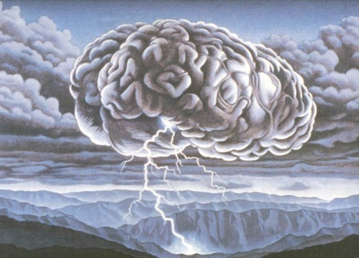
we had
HST 2008
brainstorm sessions
interviews
survey
and informal talks

Slide 5
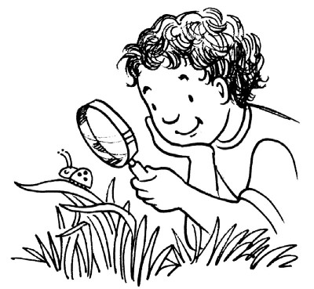
… and found three major areas of impact
Inside Classroom
Time Impact
Outside Classroom
HST 2008

Slide 6
Inside Classroom
HST 2008
choosing physics
in high school
IB Diploma
in the subject
grades increase/
decrease
new interest, webpage
CERN related topics
how universe was created
matter/
anti-matter

Slide 7
Outside Classroom
HST 2008
project work
model making
science clubs
publication work
articles, newsletters
FAQ’s

Slide 8
Outside Classroom
HST 2008
conducting workshops
educating parents
visit CERN
resources
labs, worksheets
webpage

Slide 9
Time Impact
HST 2008
8 yr. (interested in Higher
Physics & Research)
3 yr. (Physics in high school)
6 months(a lot of activity)

Slide 10
Survey results
HST 2008

Slide 11
Survey results
HST 2008

Slide 12
Proposals
HST 2008
Subject related information acquired through the programme should be used to incite the students into science. This is measureable.
The effect can be judged by observing renewed interest in the subject, better performance etc. A feedback can be given to CERN.
There should be an incentive for ex-participants to fill in the questionnaire on a regular basis, like sending them a DVD or a poster. A prize draw for teachers filling in the questionnaire each year would also help.

Slide 13
Proposals
HST 2008
An annual teacher evaluation form could be designed to determine how information from the CERN program is used in the classes. This evaluation could be sent out electronically each year and the data could be evaluated by CERN.
Asking general questions about science, its development, cosmology,
CERN and its frontier research etc.
Summer students can be asked about their background before entering university and/or high school.

Slide 14
Proposals
HST 2008
How much a teacher uses the resources material from the CERN
website can also be analyzed if there is some sort of login format.
Students can be told about the pioneering research work of science in
general and CERN in specific.
Usefulness of the field visits in the context of learning can be judged if requests for visits increase.

Slide 15
but the big question is…
HST 2008
Do teacher programs inculcate values amongst us and our
students, that is..
to work honestly and sincerely to gain knowledge and not
just for grades;
developing unbiased attitude and be open to ideas;
promoting internationalism;
in becoming a good human being.
but how to measure that…

Slide 16
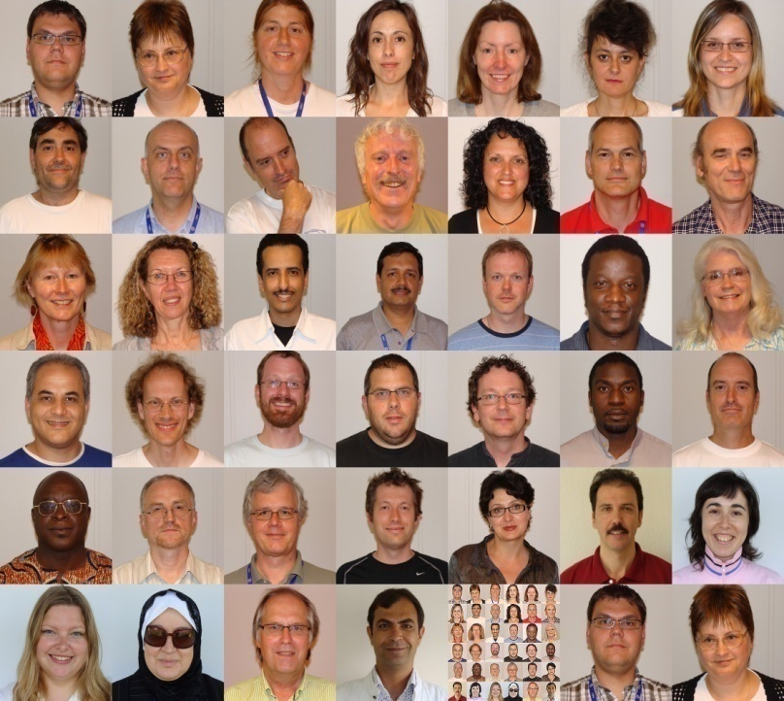
Thanks to all HST 2008 participants
HST 2008
Thanks to Frank Close, Hans Bekaert, Rolf Landua and Mick Storr
for their valuable ideas.
www.naset.org/2458.0.html http://home.howstuffworks.com/easy-outdoor
www.geocities.com/sunsetstrip/club/9651/hype.jpg
http://www.clamlynch.com/blog/brainstorm.jpg
http://www.adultschool.seq.org/images/interview.jpg
http://marketconnectionsblog.com/wp-content/uploads/2007/04/survey1.jpg
http://msp225.photobucket.com/albums/dd84/metalmoo_63/enlightenment.jpg
http://www.frankly-speaking.org/wp-content/uploads/2007/04/talking.jpg http://img.tfd.com/wn/68/662C0-gabfest.gif
internet picture courtesy:

